Slide 1
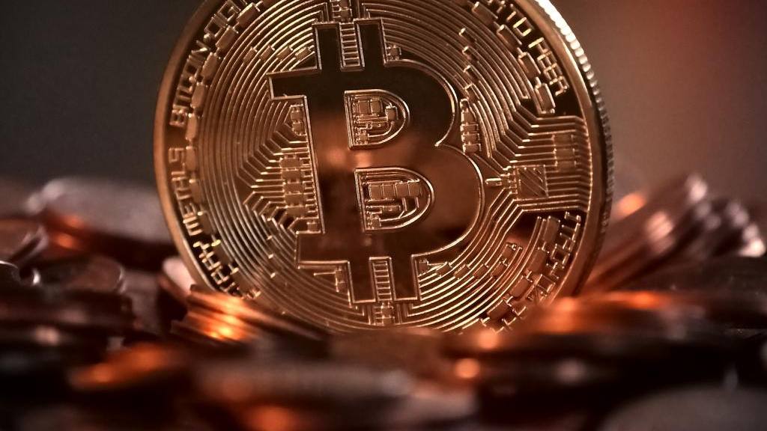
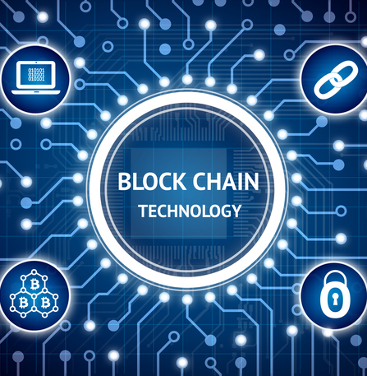
DIGITAL CURRENCY (AND NFT’s): MORE MONEY, MORE PROBLEMS AAML – Ohio Chapter October 11, 2021
Richard West, Orlando, FL
Jonathan Fields, Wellesley, MA

Slide 2
OVERVIEW
Technical stuff – what is Bitcoin and crypto?
Goal – learn enough as a lawyer to flag issues
Bitcoin/Crypto in divorce context
Property v. Income
Preservation Letters / Spoliation
Discovery Challenges
Examination of Electronic Devices
Taxation
Non Fungible Tokens (NFT’s)
Note – “A Divorce Practitioner’s Bitcoin Primer,” in JAAML

Slide 3
Critical Concepts in the Evolution of Currency
How did we get from here . . .
. . . to here?

Slide 4
IN THE BEGINNING THERE WAS BARTER

Slide 5
CHARACTERISTICS OF CURRENCY
Portability- Easily Transported
Durability - Lasts When Handled
Divisibility – Divisible Into Smaller Units
Scarcity – Supply Is Limited

Slide 6
COWRIE SHELLS
First used as currency in China 3000 years ago.

Slide 7
PRECIOUS METALS & GEMS

Slide 8
EARLY COINS

Slide 9
FIAT CURRENCY
Currency that a government has declared to be legal tender, but it is not backed by a physical commodity. The value of fiat money is derived from the relationship between supply and demand rather than the value of the material that the money is made of.

Slide 10
ANCIENT CHINESE PAPER CURRENCY

Slide 11
CREDIT CARDS

Slide 12
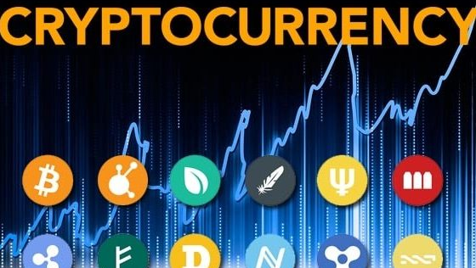
THE FUTURE IS HERE!

Slide 13
BASIS OF VALUE
Perceived – What is it worth to me
Inherent – Gold, Silver, Copper, etc.
Convertible
Gold certificates – 1882 till 1933
Silver certificates – 1878 till 1964
Gold or Silver Standard Abandoned in 20th Century
Fiat Currency – What government says it is worth.

Slide 14
BITCOIN IS BORN
2008
Satoshi Nakamoto
Bitcoin-A Peer to Peer Electronic Cash System
Bitcoin – Platform
bitcoin - Token

Slide 15
WHY CARE?
Market Cap of $1,184,360,000 (over a TRILLION DOLLARS!)
(And that's just Bitcoin!)

Slide 16
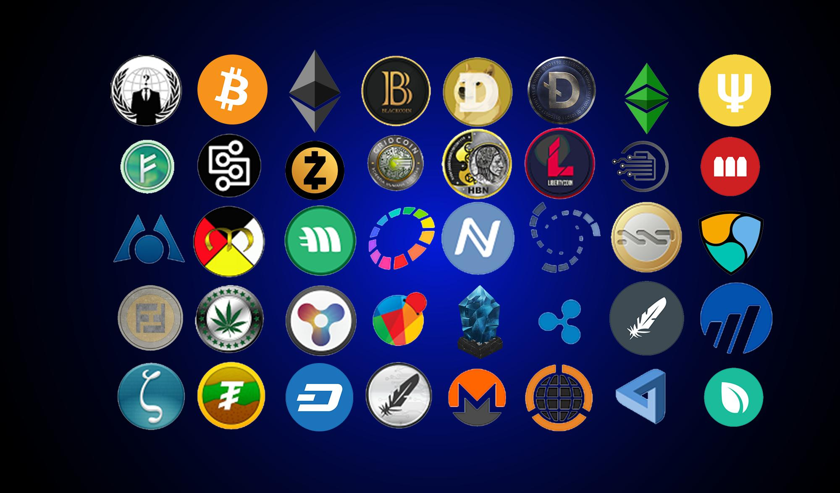
CRYPTOCURRENCIES BEYOND BITCOIN
As of March 16 2018 there were 1,658 different cryptos
Today – over 4,000!
Litecoin
Ethereum
Monero
Ripple
Many, Many More

Slide 17
UNDERSTANDING BITCOIN + CRYPTO
A decentralized peer-to-peer ledger that can validate electronic transactions allowing “online payments to be sent directly from one party to another without going through a financial institution.”
Enables virtual digital currency by solving the double-spend problem

Slide 18
DO CRYPTOS HAVE ALL THE “CHARACTERISTICS OF CURRENCY”?
Portability- Easily Transported
Durability - Lasts When Handled
Divisibility – Divisible Into Smaller Units
Scarcity – Supply Is Limited

Slide 19
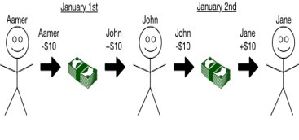
THE DOUBLE SPEND PROBLEM
A seller has to ensure the Bitcoin hasn’t been already used elsewhere.

Slide 20
DOUBLE-SPEND FIXED

Slide 21
THE DOUBLE SPEND PROBLEM

Slide 22
WHAT IS A DISTRIBUTED LEDGER?
A consensus of replicated, shared, and synchronized digital data geographically spread across multiple sites, countries, or institutions. There is no central administrator or centralized data storage.

Slide 23
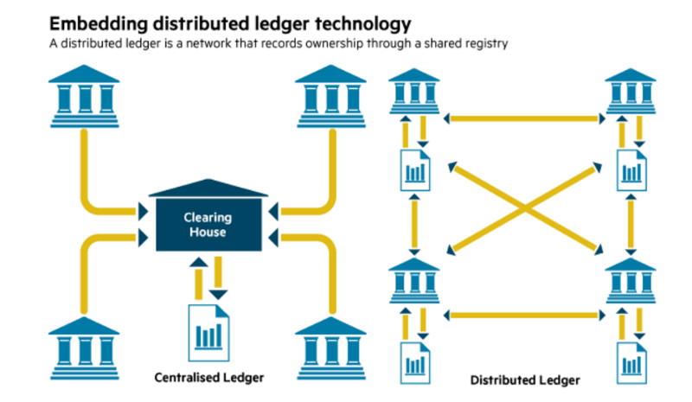

Slide 24
BLOCKCHAIN
Technology that solves the double spend problem without a centralized financial institution.
A peer-to-peer immutable distributed ledger to generate computational proof of the chronological order of transactions.
Founded upon a single, agreed-upon history of the order of transactions.
Underlying technology for Bitcoin

Slide 25
What is a Block?
Files where data pertaining to the network is permanently recorded. A block records some or all of the most recent Bitcoin transactions that have not yet entered any prior blocks. Thus a block is like a page of a ledger or record book. Each time a block is ‘completed’, it gives way to the next block in the blockchain. A block is thus a permanent store of records which, once written, cannot be altered or removed.

Slide 26
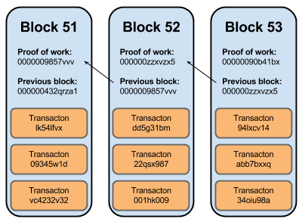
What is Blockchain Technology?
In the language of cryptocurrency, a block is a record of new transactions (that could mean the location of cryptocurrency, or medical data, or even voting records). Once each block is completed it’s added to the chain, creating a chain of blocks: a blockchain.

Slide 27
WHAT IS DECENTRALIZATION
No Single Authority
No Single Data Repository
No Single Government
No Geographical Boundary

Slide 28
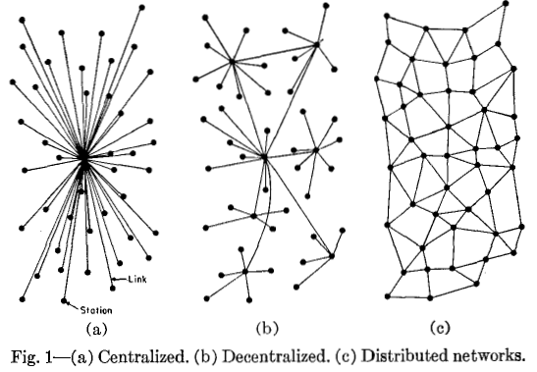

Slide 29
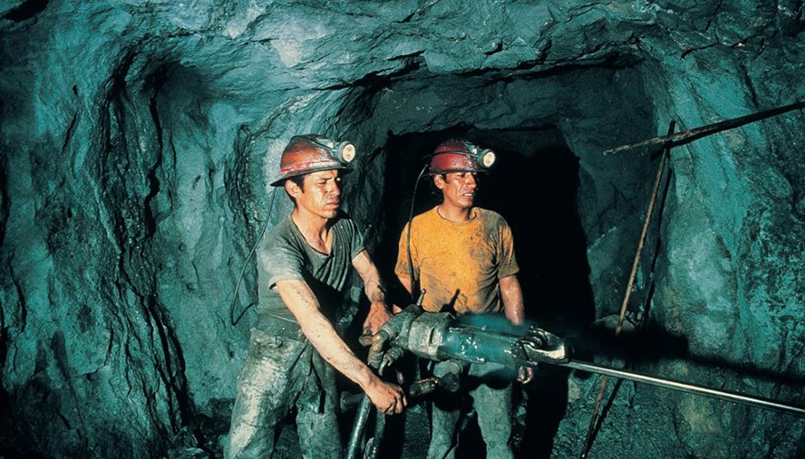
OBTAINING BITCOIN
Miners acquire new Bitcoin
Public can use an exchange

Slide 30
Mining
The process by which transactions are verified and added to the public ledger, known as the block chain, and also the means through which new bitcoin are released.

Slide 31
BITCOIN MINING WAR ROOM

Slide 32
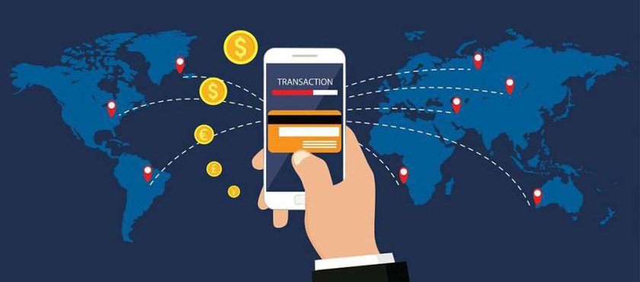
CRYPTOCURRENCY TRANSACTIONS
On-line Exchanges
Coinbase etc.
Using cryptos in the real world
In 2018 estimates are one-third of millennials own(ed) cryptos
Advantages and Disadvantages
Privacy issues
Volatility
Taxation issues

Slide 33
COINBASE SCREENSHOTS

Slide 34
WHAT IS A PUBLIC ADDRESS?
Another alphanumeric address/number which is derived from private keys only by using cryptographic math functions.
impossible to reverse engineer and reach the private key from which it was generated.
Address used to publicly receive bitcoins.
This how the Bitcoin public address looks (it always starts with 1):
1EHNa6Q4Jz2uvNExL497mE43ikXhwF6kZm

Slide 35
WHAT IS A PRIVATE ADDRESS?
A secret, alphanumeric password/number used to spend/send your bitcoins to another Bitcoin address.
A 256-bit long number picked randomly when you make a wallet.
The degree of randomness and uniqueness is well defined by cryptographic functions for security purposes.
This is how the Bitcoin private key looks (it always starts with 5):
5Kb8kLf9zgWQnogidDA76MzPL6TsZZY36hWXMssSzNydYXYB9KF
Don’t lose it
Don’t share it

Slide 36
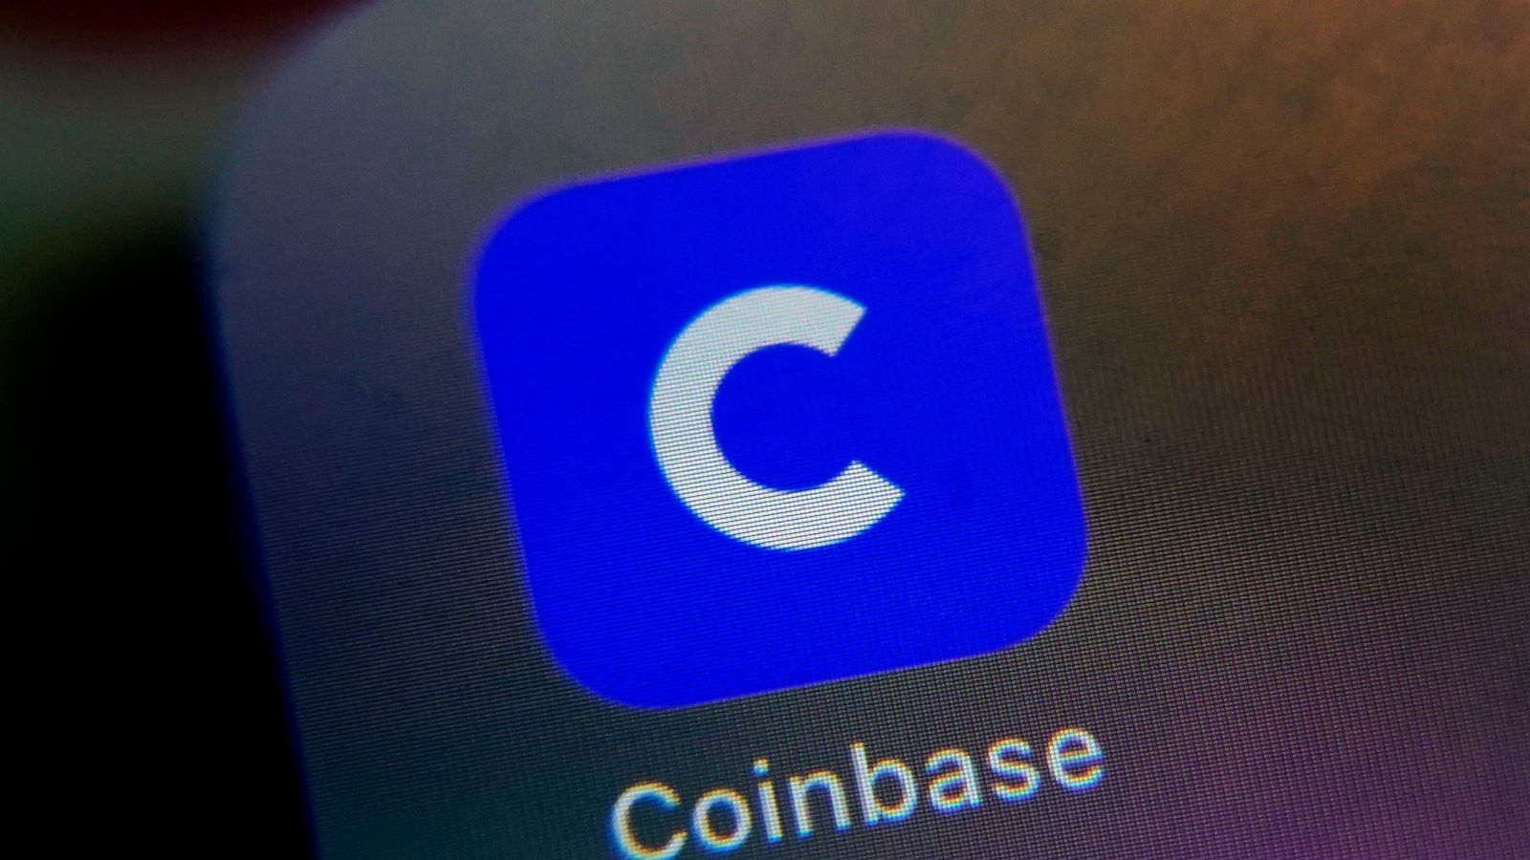
COINBASE --- SUBPOENA
United States v. Coinbase, Inc., 2019 WL 5890052 (N.D. Cal., Nov. 28, 2017)
Coinbase is a publicly traded San Francisco company.
The IRS successfully enforced a subpoena for the records of Coinbase customers. These records included transaction logs, records of payments processed, and customer correspondence.

Slide 37
BUYING / SELLING ANONYMOUSLY
Buy anonymously through a source (often an individual) listed on a decentralized peer-to-peer network such as LocalBitcoins.com
Can transact anonymously without identification verification.
Can transact for cash (and bank wire, credit card, etc.)
Issuing subpoena ineffective because the website would have no knowledge to the spouse at issue

Slide 38
BUYING / SELLING ANONYMOUSLY

Slide 39
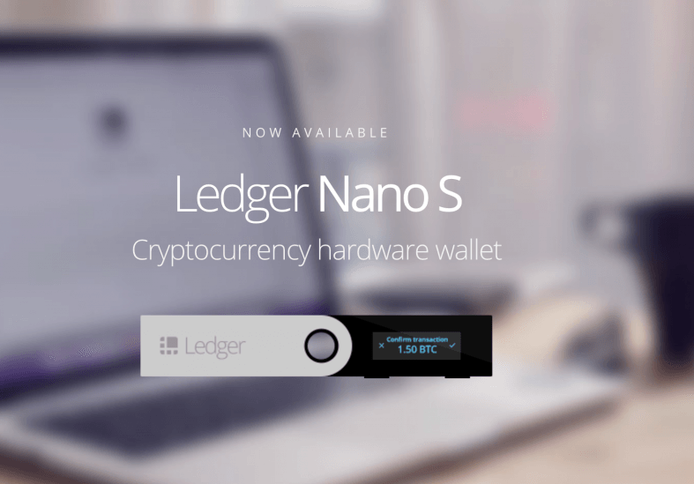
E-WALLETS AND COLD STORAGE

Slide 40
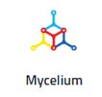
STORING BITCOIN / CRYPTO IN MOBILE WALLET APP
Store, send, and receive crypto from a wallet app on your phone (e.g. Edge, Mycelium, Bither, Breadwallet)

Slide 41
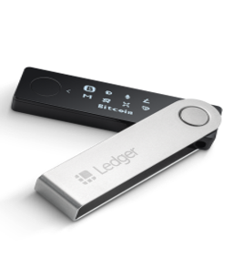
HARD WALLETS
Store, send, and receive crypto in a hardware digital wallet

Slide 42
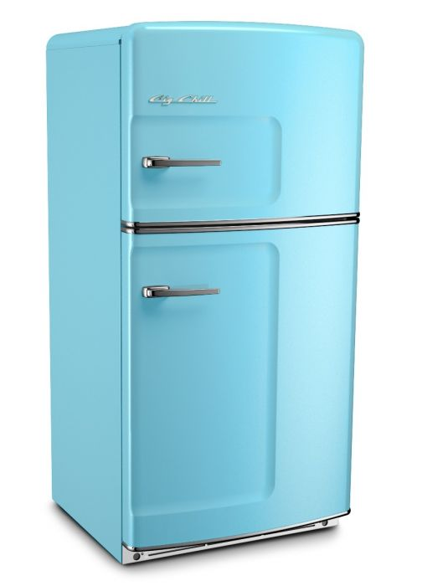
COLD STORAGE
“Hot” wallets – can store, send, and receive crypto. They are connected to the internet and vulnerable to hacking.
Cold Storage – refers to storing your crypto offline. This could be on
a thumb drive
on your computer,
or on a piece of paper

Slide 43
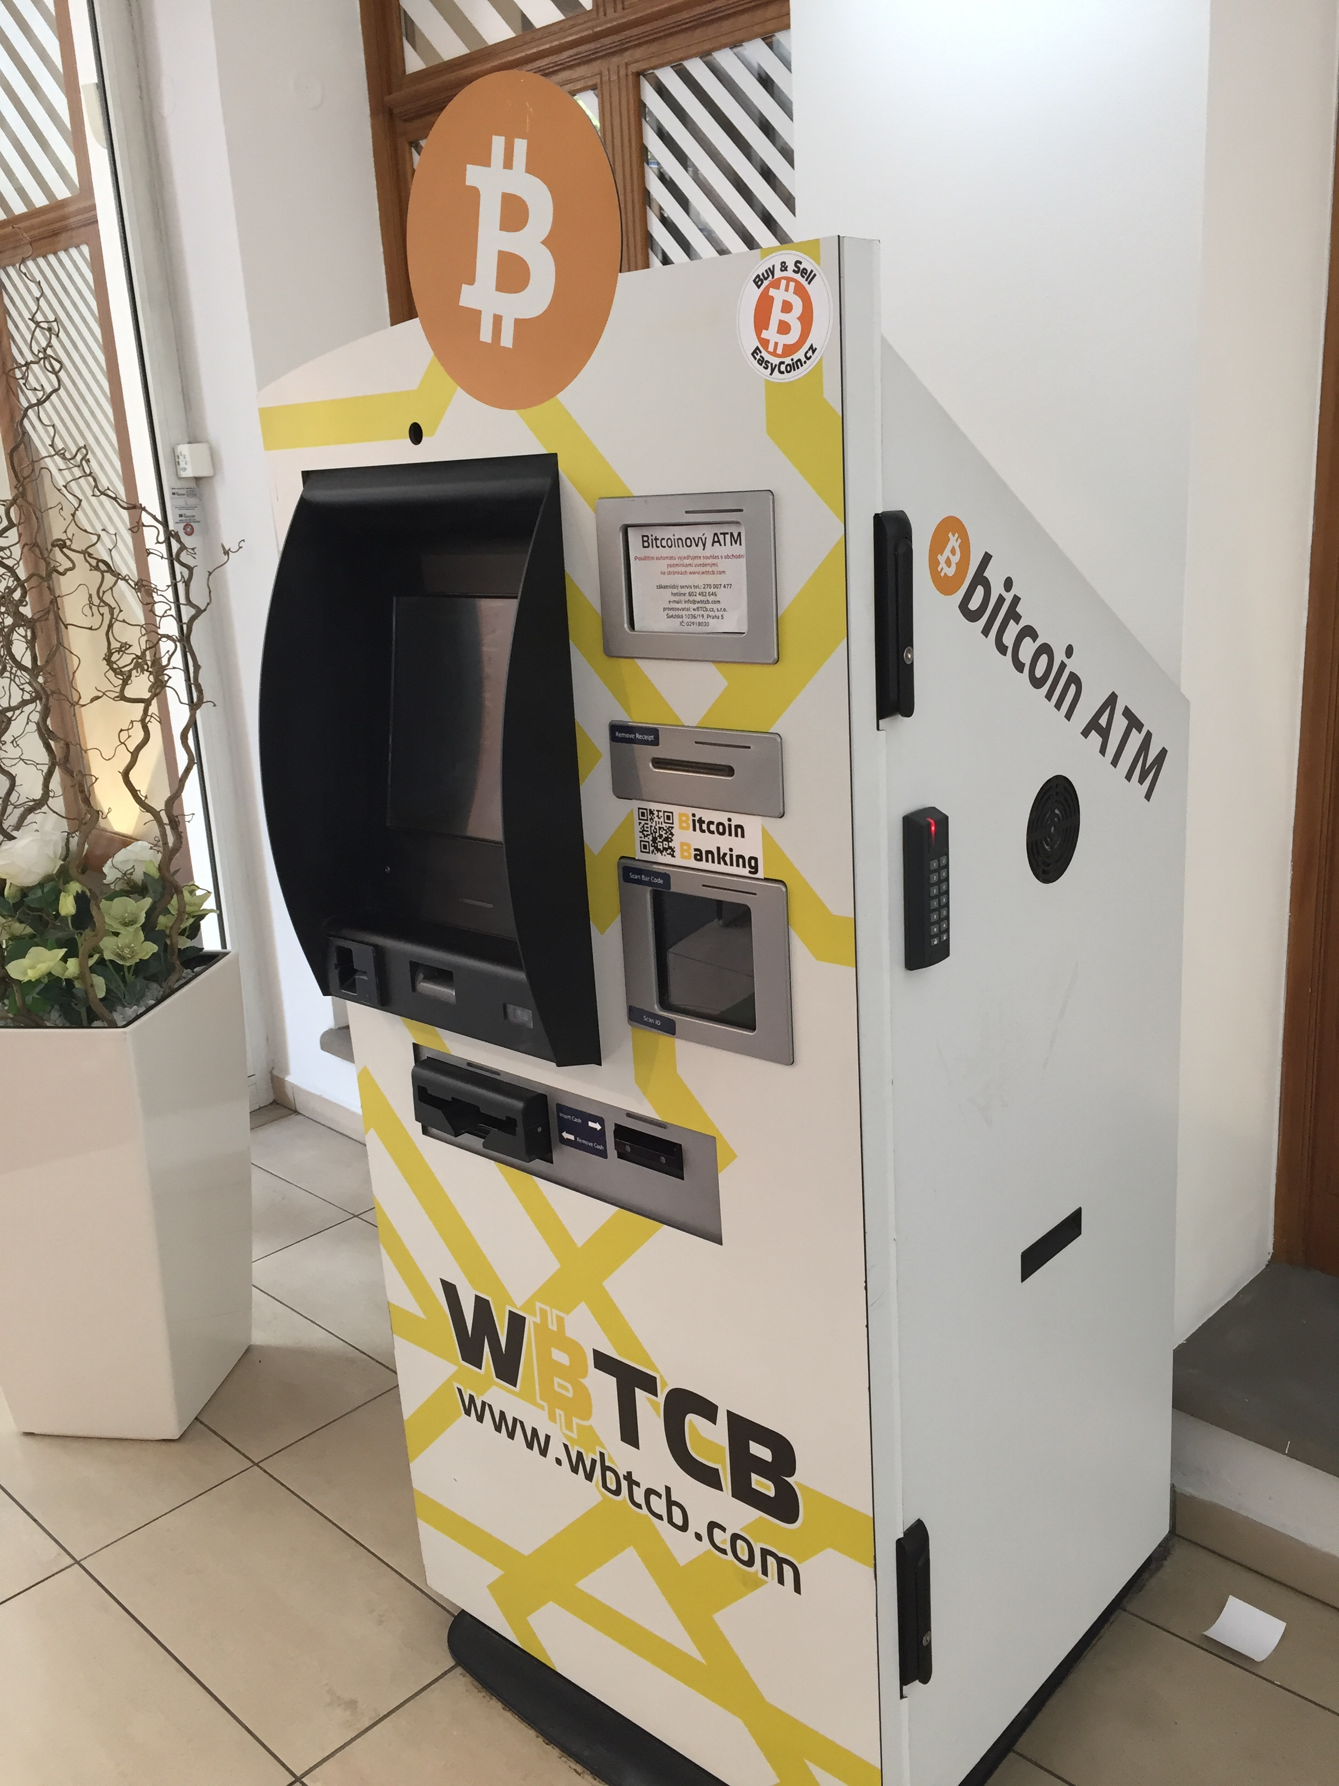

Slide 44
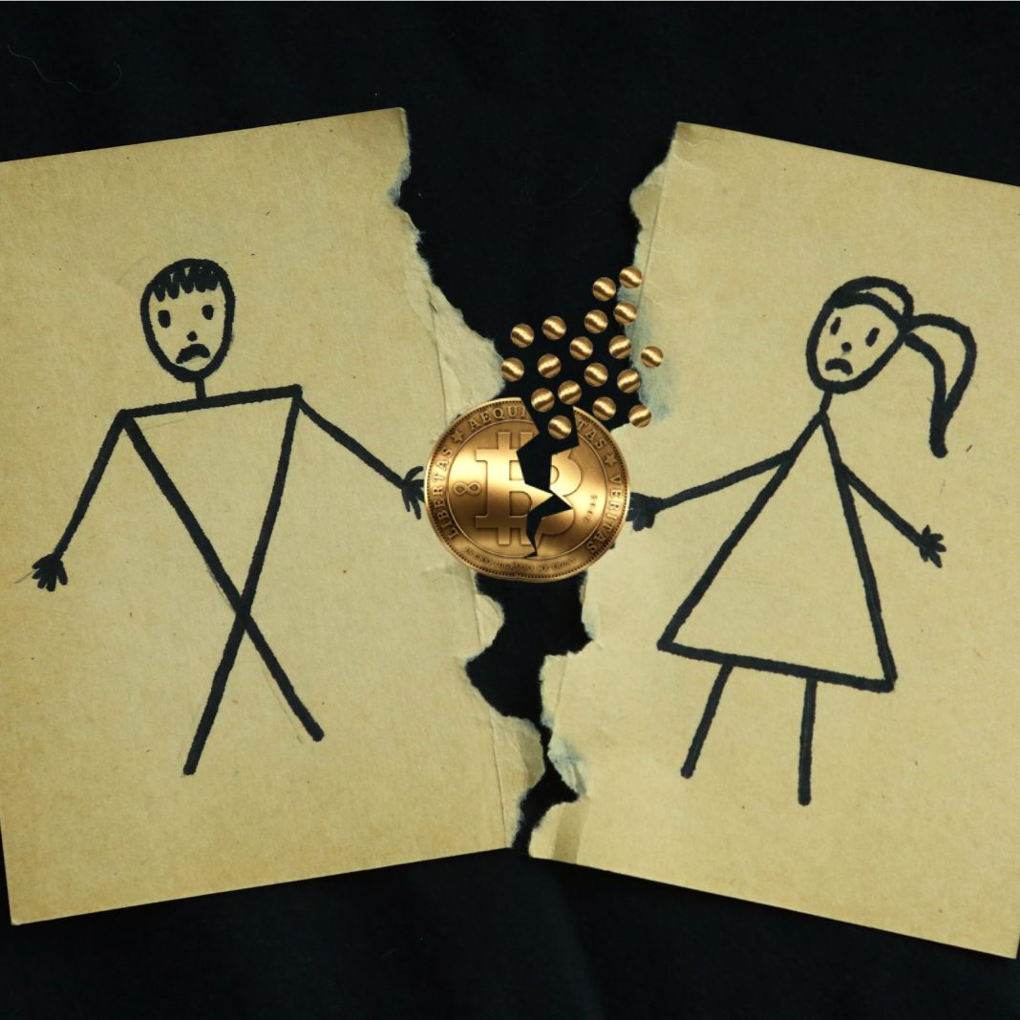
DIVORCE ISSUES
Finding/Disclosing
Value or Divide?
Dissipation/Waste
Taxation

Slide 45
CRYPTO AND DIVORCE
It’s property for purposes of division of assets in a divorce.

Slide 46
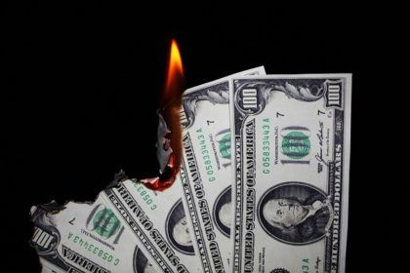
DISSIPATION?
Bad crypto investment – is it dissipation?
Just because it’s a risky investment, it may not necessarily be dissipation under your state's law.

Slide 47
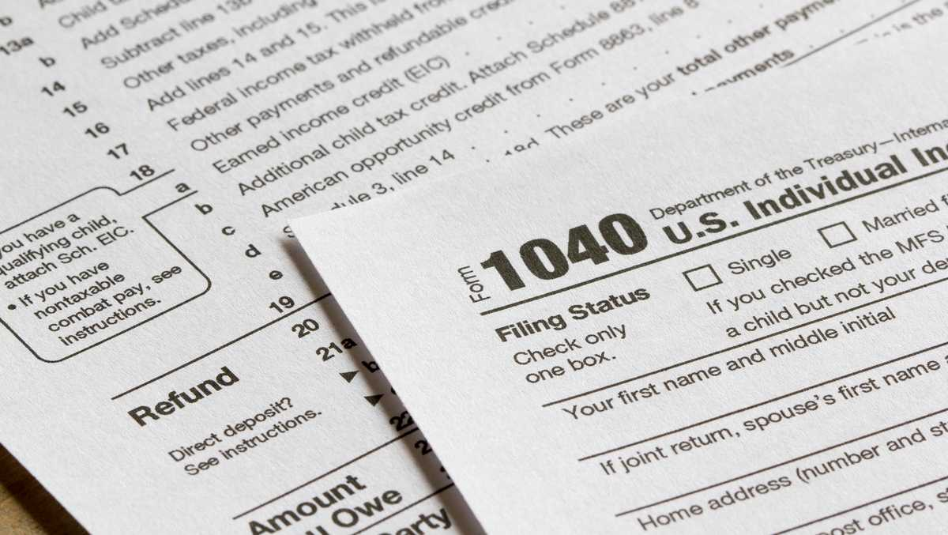
TAXATION OF BITCOIN AND CRYPTO
IRS Notice 2014 -21
Cryptocurrency is property not currency for purposes of taxation
Capital Gains apply upon sale – long-term/short-term
(Schedule D / Form 8949)
Using crypto to buy something is taxable to the buyer and treated as a sale
If worker is paid in crypto, payroll taxes could be due

Slide 48
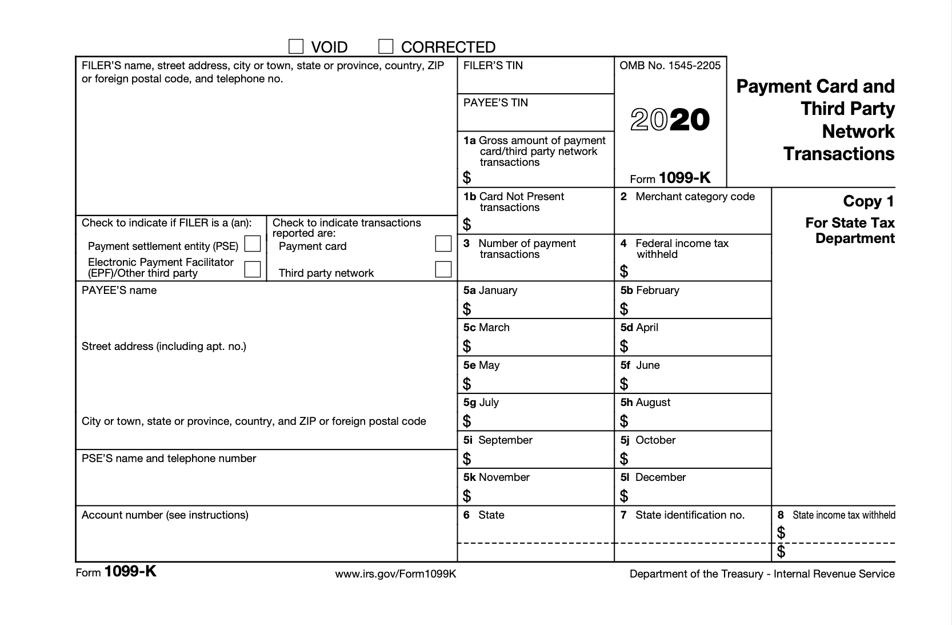
TAXATION OF BITCOIN AND CRYPTO -- IRS REPORTING REQUIREMENTS--
US based centralized exchanges (e.g. Coinbase, Kraken)
required to generate 1099-K forms to their US clients provided:
crypto is received in your business for goods or services rendered in any amount or
for non-business purposes, total amount of such transactions exceeds $20,000 and the aggregate number of such transactions exceeds 200
For residents of VT and MA, lower thresholds ($600) apply.

Slide 49
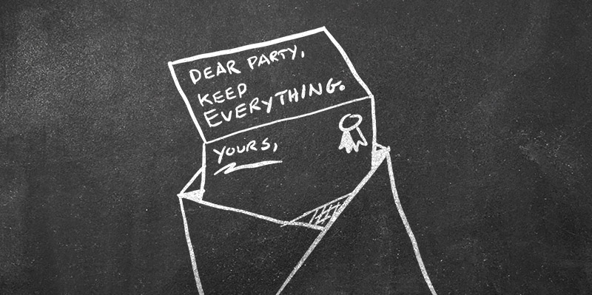
CRYPTO AND DIVORCE: PRESERVATION LETTER
Worried about laptops and phones mostly
To remind opponents to preserve evidence, to be sure the evidence doesn’t disappear

Slide 50
CRYPTO AND DIVORCE: PRESERVATION LETTER
Linchpin of a subsequent claim for spoliation*, helping to establish bad faith and conscious disregard of the duty to preserve relevant evidence
Remind opponent of ”overwrite” so they should be encouraged to copy (or “image”) drives immediately.
*Spoliation is the loss or destruction of evidence a party had a duty to preserve. If court finds, sanctions can preclude evidence or adverse inference.

Slide 51
CRYPTO: Normal discovery rules still apply
Discovery Methods –
Interrogatories, Request for Documents, Production of Documents or Things for Inspection and Other Purposes [“THINGS” CAN MEAN HARD DRIVES]
Scope of Discovery -
Parties may obtain discovery regarding any matter, not privileged, which is relevant to the subject matter ….reasonably calculated to lead to the discovery of admissible evidence.

Slide 52
PROTECTIVE ORDERS
To defend against a request for access to client’s hard drive:
Upon motion by a party or by the person from whom discovery is sought, and for good cause shown, the court …. may make any order which justice requires to protect a party or person from annoyance, embarrassment, oppression, or undue burden or expense….
(Fed.Rule.Civ.Pro. 26, as an example)

Slide 53
CRYPTO AND DIVORCE: WRITTEN DISCOVERY
Interrogatories, Requests for Documents – we can send samples

Slide 54
CRYPTO AND DIVORCE: GETTING ACCESS TO EVIDENCE
Work with forensic expert to draft pleadings or enter stipulation with opposing party
Agree to (or argue for) a protocol:
Time period
Search parameters (eg. Keywords, communications)
Forensic experts
Procedure to deal with privilege / irrelevant data (“You can’t just hand over the whole hard drive to the other side”)

Slide 55
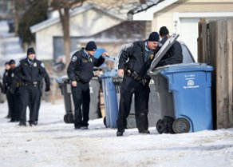
GOING THROUGH THE EVIDENCE
See if there is any indication of use or investment in cryptocurrency
Bank statements to wallet providers
Extract cell phone data, look for wallet apps
Get wallet ID and trace the Blockchain
Look for large flows in/out of wallet

Slide 56
FOLLOW THE MONEY
Caveats- much easier said than done!
Blockchain Analysis (use a forensic expert!)
Accessing wallet: PINs, passwords, etc.
Disposable wallets: temporary credit cards

Slide 57
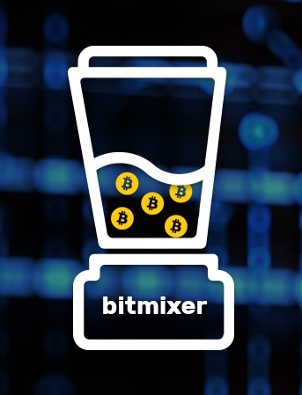
What is Tumbling
Cryptos are fungible
Coin tumbling platforms combine a bunch of transactions together putting grain in a silo where eventually everyone gets the value back while obfuscating the origin of the funds.
Sites include Bitcoinlaundry, Bitmix, Bitlaundry,
Monero- without tumbling services due to its privacy centric design, utilizing ring signatures to keep the entire blockchain secure and untraceable.

Slide 58
Non-fungible tokens (NFT’s)
“Non-fungible tokens (NFTs) are unique, digital items with blockchain-managed ownership. Examples include collectibles, game items, digital art, event tickets, domain names, and even ownership records for physical assets.” “The NFT Bible”. See https://opensea.io/blog/guides/non-fungible-tokens/
“unforgeable digital certificates”
Why Lawyers Should Care about NFT’s, Patrick Wright, Esq., Dallas TX (AAML Fellow) (excellent reference article)
These are assets for purposes of divorce.
They are NON-fungible and unique (compare to Bitcoin – which is fungible)

Slide 59
NFT - art
Art --- Beeple – sold NFT for almost $70,000,000 in March 2021
https://www.beeple-crap.com/

Slide 60
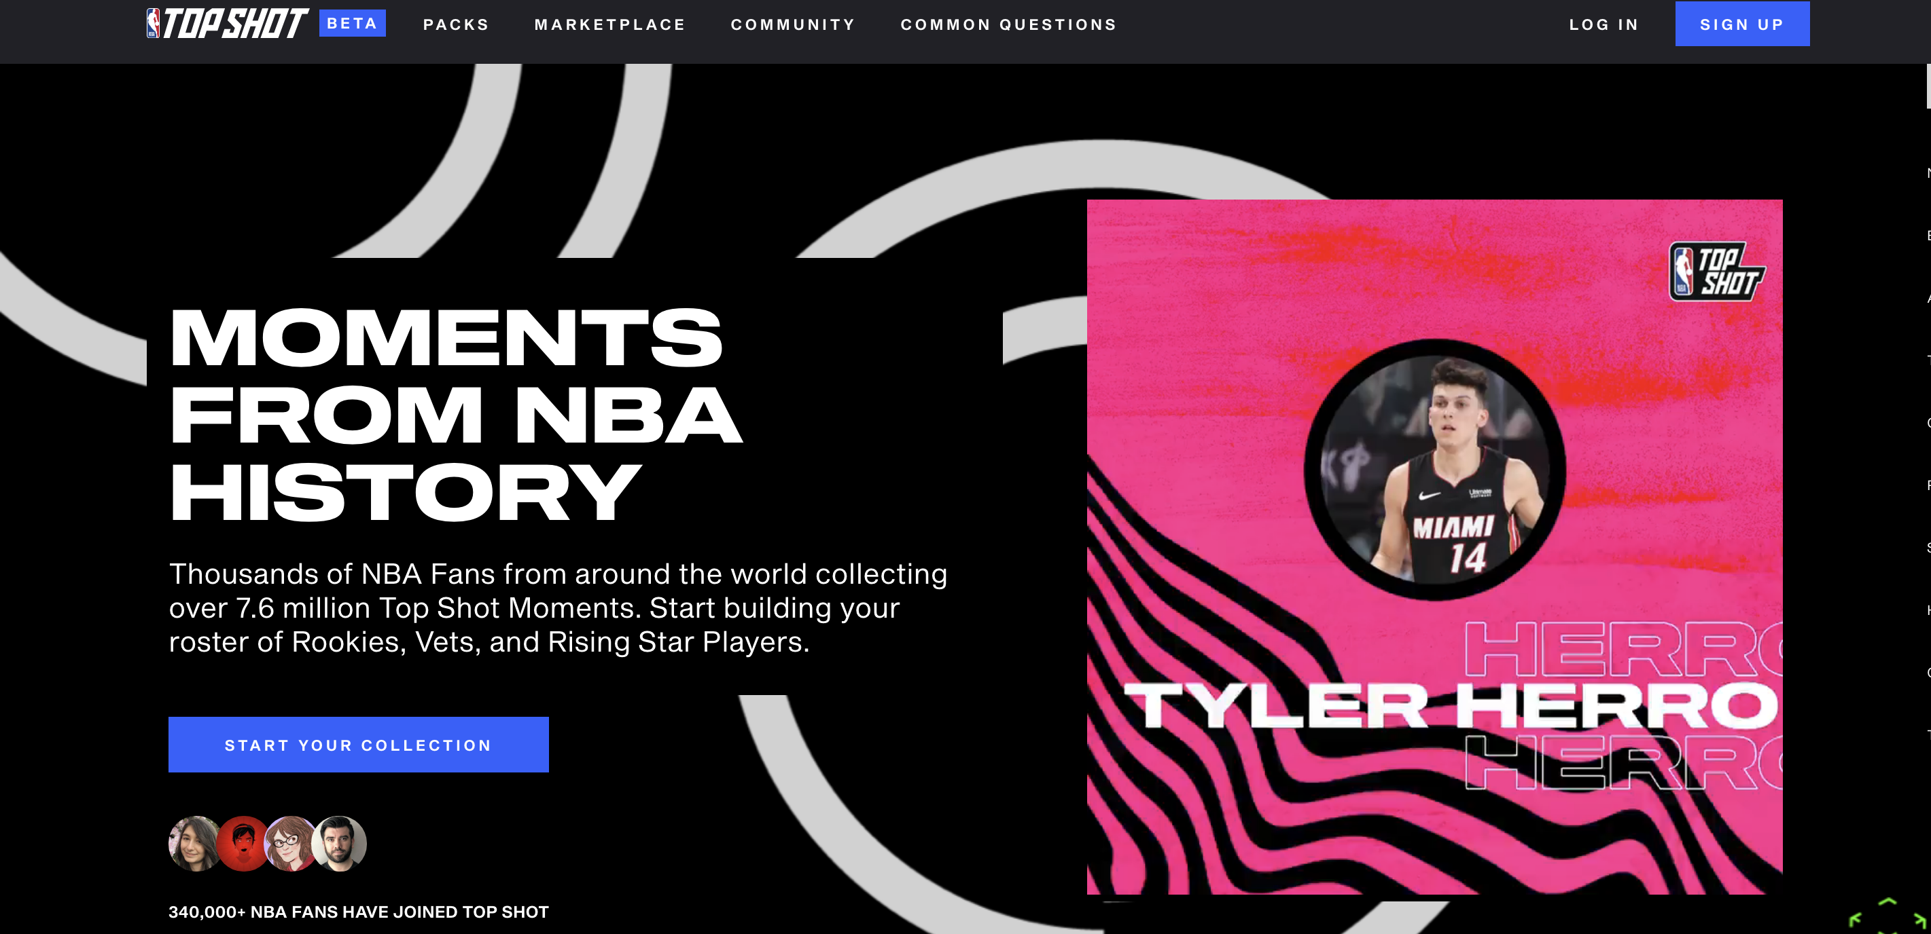
NFT – “NBA Moments”
https://nbatopshot.com/
Digital basketball highlights (video)
LeBron James highlight sold for $200,000

Slide 61
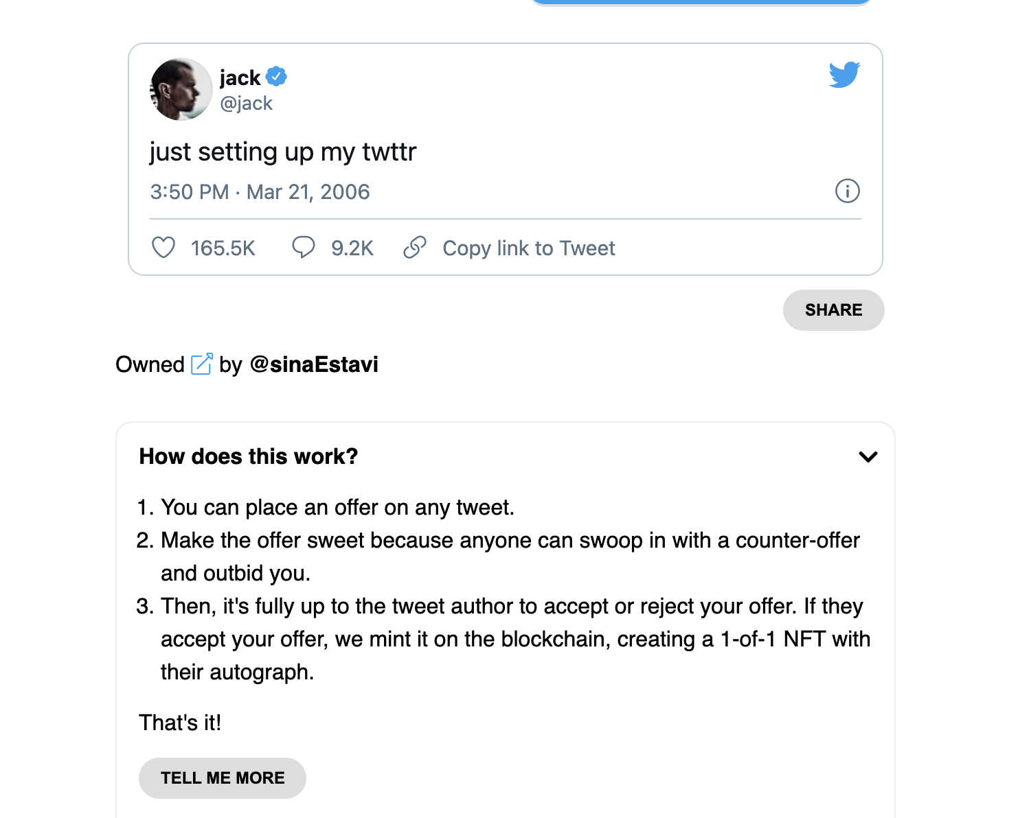
Sell a tweet as NFT
Jack Dorsey, Twitter founder, sold his first tweet as an NFT for over $2.9m. (https://v.cent.co/ is website that trades in tweets as NFT’s)

Slide 62
Fini!

